Slide 1












RMIT Business Analyst Champion
Season 2
RMIT Business Analyst Champion
ROUND 3 CASE STUDY
ROUND 3 CASE STUDY
<The Bold Type>
Bui Thu Uyen
Hoang Huong Giang
Pham Thi Thao
Nguyen Hai Ha

Slide 2

Executive Summary
Situation: SP Co. is a leading company which provides high-quality products in 3 regions. However, current production capability of each region tends to be insufficient to cater demand itself at the moment and in the future.
Complication
It forces SP Co. to take actions in 3 scenarios.
1. In Y0, the actual supply is insufficient to fulfill demand, each region has to receive goods from the others, so that SP Co has to spend huge amount on primary cost.
2. In the next 3 years, the forecasted demand volume is much higher than production capability, therefore SP Co. plans to install new line.
3. Insufficient capacity also affects CAN HF (New) launching plan, so SP Co. needs to select the most optimal solution among 3 proposed ones.
Question
1. How can SP. Co reduce primary cost? Should it reduce superfluous transported volume and optimize transportation route?
2. After new lines installation, can SP Co. fulfill the demand? If no, which actions does SP Co. take?
3. What is the best option (in terms of profitability and potential risk) for SP. Co to launch the CAN HF new product in the North?
RBAC 2021 - Round 3
Page 1
Executive Summary | Primary Cost in Y0 > Recommendations | New Product Launch Analysis > Recommendations | Recap

Slide 3
In Y0, the actual supply is insufficient to fulfill demand so that each region has to receive goods from the others
RBAC 2021 - Round 3
Page 2
Executive Summary | Primary Cost in Y0 > Recommendations | New Product Launch Analysis > Recommendations | Recap

Slide 4
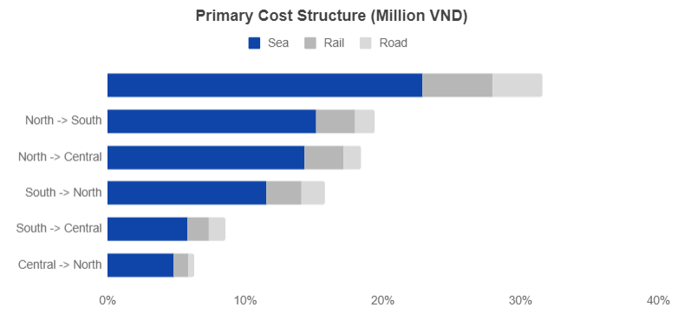


As a result, SP Co. had to spend 47,089 million VND on primary cost
Primary Cost is calculated by:
In which Primary Cost/ Ton regards to Cost of Trans. Routes & Trans. Types
(unit: VND/ ton)
Primary Cost
(VND)
Product weight
(ton)
Primary
Cost per ton
(VND/ton)
363,418
=
x
380,638
409,502
396,786
636,074
RBAC 2021 - Round 3
478,851
Central
-> South
North
-> Central
Central
-> North
Sea
Rail
Road
Currently SP Co. had organized the routes with appropriate transportation modes
Central -> South
SP is using efficient trans. route with the cheapest one Central -> South dominating cost structure (31.6%)
Reasonable trans. type ratio in every route: Sea > Rail > Road,
in which Sea ratio dominates over 80%
Page 3
Executive Summary | Primary Cost in Y0 > Recommendations | New Product Launch Analysis > Recommendations | Recap

Slide 5

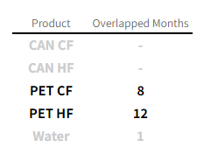
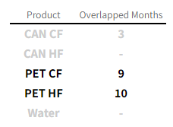
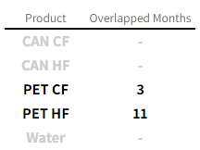

However, primary cost is still not optimized due to the unnecessary
primary volume and all transportation routes in use
PET CF, PET HF were usually transported in and out between 2 regions in the same month, which leads to redundant primary volume
All routes were used, which made it inevitable to avoid expensive routes
Route | Cost per ton (VND/ ton)
South -> North | 489,949
North -> South | 450,677
South -> Central | 442,140
Central -> North | 409,502
North -> Central | 380,638
Central -> South | 363,418
North
RBAC 2021 - Round 3
Central
North -> South and South -> North routes, which both have highest cost/ton, accounting for a large amount in cost structure (total 35.17%)
South
Page 4
Executive Summary | Primary Cost in Y0 > Recommendations | New Product Launch Analysis > Recommendations | Recap

Slide 6


Therefore, each region should take advantage of production based on
2 criteria respectively - volume & transportation route by type
Context
Each region has its own key products with enormous supply surplus that can be transported to other regions having supply shortage
North
Central
South
Production advantage of regions
Water
CAN CF
RBAC 2021 - Round 3
PET HF
PET CF
Only transport products from region with supply surplus
Prioritize region with the biggest demand size for long-term cash flow
Ensure overall transportation weight < max capacity per month -> no effect on lead time and next month’s supply
Solution
“Right Place, Right Ratio”
Plan ahead the number of Trans. Routes and Trans. Type Ratio
Prioritize route Central <-> South/North
Maintain the following ratio by type: Sea > Rail > Road
Page 5
Executive Summary | Primary Cost in Y0 > Production Capability in Y1-3 > Can HF(New) Launching | Recap

Slide 7

As a result, SP Co. can save total primary cost by 38.36 %
Pet CF
Pet HF
Water
CAN CF
767K rcs
226K rcs
964K rcs
16K rcs
RBAC 2021 - Round 3
567K rcs
251K rcs
141K rcs
2578K rcs
75K rcs
57K rcs
515K rcs
113K rcs
Cost saving
6,528 million VND
Cost saving
4,917 million VND
Cost saving
3,521 million VND
Cost saving
3,098 million VND
Total cost saving of 4 products: >18 billion VND
North
Central
South
Note: There’s 1% remaining stock of each sending location and 5% transportation volume for risk management
Page 6
Executive Summary | Primary Cost in Y0 > Production Capability in Y1-3 > Can HF(New) Launching | Recap

Slide 8
In the next 3 years, the given forecasted demand will outweigh SP Co.’s production capability nationally
RBAC 2021 - Round 3
Page 7
Executive Summary | Primary Cost in Y0 > Production Capability in Y1-3 > Can HF(New) Launching | Recap

Slide 9
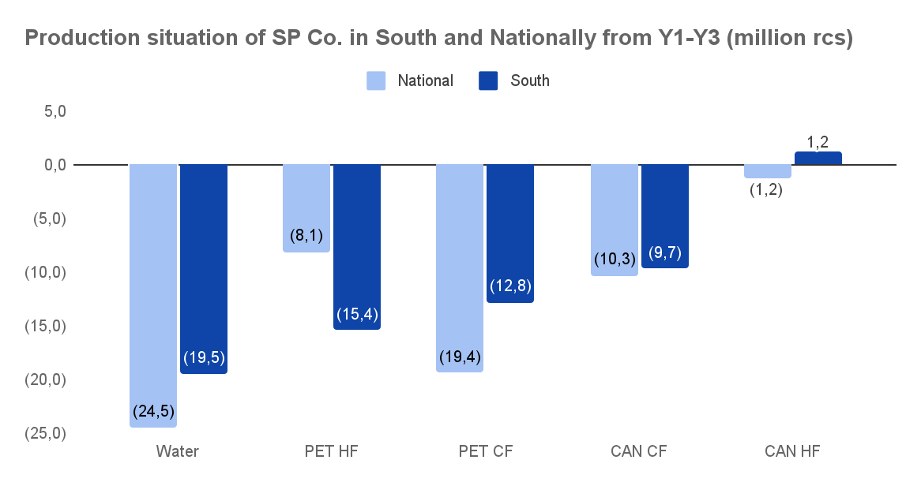
Especially in the South, which has the biggest market size
RBAC 2021 - Round 3
From Y2, the company plans to increase production capacity in South by installing 3 new production lines for Water, PET HF, PET CF in South - products with highest supply shortage
Page 8
Executive Summary | Primary Cost in Y0 > Production Capability in Y1-3 > Can HF(New) Launching | Recap

Slide 10
However, the supply is still insufficient to cater all forecast demand nationally
After calculating the increased supply by new production lines at different points of time, SP Co. still faces supply shortage nationally
WATER
PET CF
PET HF
(2.77)
million rcs
in Y2-3
(10.9)
million rcs
in Y2-3
(1.4)
million rcs
in Y3
RBAC 2021 - Round 3
To fulfill the forecast demand in 3 years, installing new production lines is not enough
In reality, plants do not supply at their full capacity since they need to incorporate a capacity surplus for demand uncertainty.
Regarding SP company case, its actual supply is calculated as:
Actual supply = Max capacity x Capacity utilization rate
Needs to increase
Optimized with new production line
SP has not taken any action
Additional solution
SP. Co can optimize its capacity utilization rate of 5 products that help the company meet the sales demand from Y1 to Y3
Page 9
Executive Summary | Primary Cost in Y0 > Production Capability in Y1-3 > Can HF(New) Launching | Recap

Slide 11





SP Co. has not successfully optimized capacity utilization rate due to unequal distribution throughout the year among products
108%
108%
98%
97%
90%
84%
82%
75%
RBAC 2021 - Round 3
71%
64%
66%
59%
59%
50%
49.5%
50%
51%
47.5%
35%
30%
21%
15%
15%
CAN CF
CAN HF
PET CF
PET HF
Water
evaluate the distribution of capacity utilization rate in 12 months: Greater range means the rate is distributed with large gap between the lowest and highest of the year
Quartile formula
is used to
determine 3 levels of capacity utilization rate: high, average, low
Page 10
Executive Summary | Primary Cost in Y0 > Production Capability in Y1-3 > Can HF(New) Launching | Recap

Slide 12
Therefore, besides the installation plan, increasing current capacity utilization rate from Y1 by levels can be added to strengthen the solution
90%
High
SP can consider optimizing production by upgrading % capacity utilization level each year (only applicable to those of Low and Average level)
75%
RBAC 2021 - Round 3
Average
To minimize optimization cost: In 1 year, it can just apply one change - increasing capacity utilization rate or production lines
47.5%
Low
In Y1, SP. Co. should increase Capacity utilization of the existing lines
since cost of increasing utilization rate < initial cost of installing production line from Y1
15%
CAN CF as an example
Page 11
Executive Summary | Primary Cost in Y0 > Production Capability in Y1-3 > Can HF(New) Launching | Recap

Slide 13
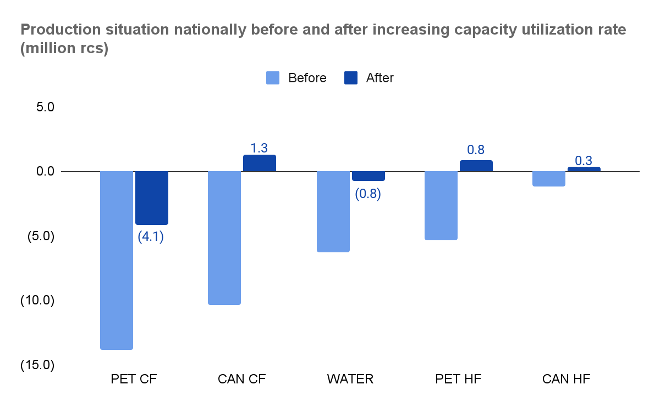
So, SP Co. can follow the timeline underneath to minimize supply shortage
Y1
Upgrade Low capacity utilization rate to Average level of 5 products in 3 regions
Y2
WATER and PET CF install the new production line → stop upgrade
CAN CF, CAN HF & PET HF have no installation → upgrade Average capacity utilization rate to High rate
im
RBAC 2021 - Round 3
Impact
Y3
PET HF install the new production line → stop upgrading
CAN CF, CAN HF already reach High utilization rate → stop upgrading
However, PET CF still can not meet the demand volume
Recommended timeline for all products
Page 12
Executive Summary | Primary Cost in Y0 > Production Capability in Y1-3 > Can HF(New) Launching | Recap

Slide 14
So, for PET CF, we recommend to move forward timeline for installing its new production line from M7-Y2 to M4-Y1
By installing new production line from Y1, there will be no adjustment to capacity utilization rate for PET CF in South
Before
After
Y1 74,098
Y2 (925,748)
Y3 (1,365,351)
Y1 803,269
Y2 81,677
Y3 1,336,544
South
transport
the surplus
Suggested maximum capacity volume by line (Million Rcs)
RBAC 2021 - Round 3
Line/ Region/ Installation time | Y1 | Y2 | Y3
PET CF/ South/ Y1-M04 | 3.0 | 4.1 | 4.1
Y1 (756,623)
Y2 (925,748)
Y3 (2,437,508)
Y1 (27,453)
Y2 (228,120)
Y3 264,387
National
The aforementioned solution for all products is only implemented when:
(1) If Revenue > Cost, there is no constraint
(2) If Revenue < Cost, to retain the market share, SP Co. can still take actions up to a certain acceptance rate (*)
(*) The rate varies depending on company’s situation
Page 13
Executive Summary | Primary Cost in Y0 > Production Capability in Y1-3 > Can HF(New) Launching | Recap

Slide 15
RBAC 2021 - Round 3
Insufficient capability also affects the launching plan of CAN HF (New) in the North
Page 14
Executive Summary | Primary Cost in Y0 > Production Capability in Y1-3 > Can HF(New) Launching | Recap

Slide 16


So that SP Co. needs to select the most optimal options among 3 proposed ones
1
Use Primary Transportation to spare more capacity:
CAN HF New: South → North
CAN CF: North → South
Criteria to Choose
RBAC 2021 - Round 3
RBAC 2021 - Round 3
Highest Long-term Profitability
2
Hire a Co-packing service for CAN HF (New) in the North:
Co-packing fee: 22,000 VND/Rcs
Transportation Co-packer → Warehouse: 1,000 VND/rcs
+
3
The Most Controllable Risks
Upgrade production capacity in the North by 67%
Initial investment: $1 Million(70% CAPEX & 30% OPEX)
Maintenance cost/ year: 2.5% CAPEX
Useful life cycle: 7 years
Page 15
Executive Summary | Primary Cost in Y0 > Production Capability in Y1-3 > Can HF(New) Launching | Recap

Slide 17
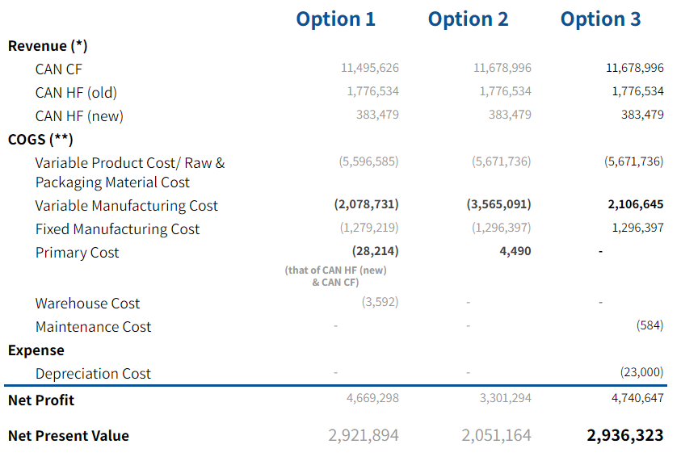

Option 3 is the best option regarding PROFITABILITY in 7-year period
Regarding Cost Structure
Option 3 does not bear high primary cost & not face the trade-off of CAN CF sales compared to Option 1
Option 3 has lower variable manufacturing cost (without packing fee) compared to Option 2
RBAC 2021 - Round 3
( )
Sales in million
(*) Revenue is estimated by forecasted sales demand of 3 products and
the equal assumed selling price
(**) COGS is sum of COGS of 3 products
Option 3 yields the greatest profit in 7-year period
Page 16
Executive Summary | Primary Cost in Y0 > Production Capability in Y1-3 > Can HF(New) Launching | Recap

Slide 18
Besides, downside risks should be mitigated
due to its dual effect on the profitability
 | Option 1 | Option 2 | Option 3
Potential Risk | Untimely Supply | Additional Fee Charged | Failed Sales Goals
 | Emerging risks during trans. process such as burning, damaging, attacking Over 80% CAN HF New is transported by sea way -> extreme weather barriers | Co-packing third parties increases their service fee | Actual sales demand does not meet sales demand forecast
Consequence | Transport delay can lead to untimely supply & lose market share | Reduce profit margin or lose price competitive advantage | Reduce return rate or make loss
 | Difficult to control due to objective problems | Difficult to control due to objective problems | Can be controlled through re-planning initial investment
RBAC 2021 - Round 3
Evaluation
Option 3 has the most manageable risks
Page 17
Executive Summary | Primary Cost in Y0 > Production Capability in Y1-3 > Can HF(New) Launching | Recap

Slide 19
To solve the aforementioned risk of falling demand for option 3,
SP Co. can consider minimizing the production capacity
Capacity & investment optimization in 7 years
Total forecasted sales demand CAN HF (rcs) 25,094,884
Forecasted sales demand CAN HF Old (rcs) 20,604,488
Forecasted sales demand CAN HF New (rcs) 4,490,396
Total current supply of CAN HF (rcs) 18,778,795
Optimized production capacity need to increase (%) 33.63
Optimized CAPEX investment (M VND) 8,082
RBAC 2021 - Round 3
Impact
Reduce the initial investment by 34,86%
Initial investment after being optimized is 14,982 (M VND)
(*) Reducing production capacity increase does not affect the the amount of supply for sales demand of CAN HF (New) in the North in 7 years
Page 18
Executive Summary | Analysis > Recommendations
Executive Summary | Primary Cost in Y0 > Production Capability in Y1-3 > Can HF(New) Launching | Recap

Slide 20
After being optimized, even in the bad scenario of reducing sales demand by 30%, Option 3 is still the most profitable
 |  | Option 3
COGS (**)
 | Variable Product Cost/ Raw & Packaging Material Cost | (5,636,649)
 | Variable manufacturing Cost | (2,093,612)
 | Fixed Manufacturing Cost | (1,288,377)
 | Primary Cost | -
 | Warehouse Cost | -
 | Maintenance Cost | (409)
Expense | Depreciation Cost | (14,982)
Net Profit |  | 4,719,366
Net Present Value |  | 2,928,509
Revenue (*)
CAN CF 11,678,996
CAN HF (Old) 1,776,534
CAN HF (New) 268,435
RBAC 2021 - Round 3
Net Present Value after optimization
Option 1 2,925,594
Option 2 2,027,296
Option 3 2,928,509
→ Option 3 is still the most profitable
Page 19
Executive Summary | Primary Cost in Y0 > Production Capability in Y1-3 > Can HF(New) Launching | Recap

Slide 21
Analyses & conclusions recap
1
Product weight
The lower product weight, the lower primary cost
Overlapped transport of PET CF, PET HF, CAN CF, Water leads to redundant primary volume
All routes were used, which made it inevitable to avoid expensive routes
Transport product(s) from the region(s) when Demand > Supply
Prioritize route Central <-> South/North & maintain the current of ratio of transportation type: Sea > Rail > Road
RBAC 2021 - Round 3
is mainly
affected by
Transportation frequency & region:
Central → South is the cheapest route
& the root causes
are solved
by
Transportation route
Primary Cost
in Y0
Transportation type
Transportation type and ratio of each type: Sea is the cheapest, followed by Rail and Road
Results in
18 bil cost saving
(~38% initial cost)
Page 20
Executive Summary | Analysis > Recommendations
Executive Summary | Primary Cost in Y0 > Production Capability in Y1-3 > Can HF(New) Launching | Recap

Slide 22
Analysis & conclusions recap
All products: From Y1, upgrade Low and Average capacity utilization rate consecutively until installing new production line
↑ Max capacity
Plans to install production line from Y2
problem
not enough to cater upcoming demand
2
RBAC 2021 - Round 3
to fulfill forecasted demand
can increase by
Production
Capability
in Y1-3
↑ Capacity utilization rate
Has no plan to be improved yet but can consider to improve
Unequally contributed among months with significant difference
problem
PET CF: Move installation timeline from M7-Y2 to M4-Y1
Results in
reduce supply shortage nationally by 8.2% ~ 38,696,681
Page 21
Executive Summary | Analysis > Recommendations
Executive Summary | Primary Cost in Y0 > Production Capability in Y1-3 > Can HF(New) Launching | Recap

Slide 23
Analyses & conclusions recap
3
(1) Use Primary Transportation to transfer:
CAN HF New: South → North
CAN CF: North → South.
RBAC 2021 - Round 3
Profitability in 7-year period
Potential downside risks
has 3 options
(2) Hire a Co-packing service in the North
with addition Co-packing and primary
transportation to WHs cost
which are evaluated by
Select option 3 &
Recommend to reduce initial investment by optimizing production capacity
Can HF (New) Launching
to select the most optimal
(3) Upgrade production capacity in the North
Results in
Total profit increases
by 38,32% + remains being the most profitable solution
Page 22
Executive Summary | Analysis > Recommendations
Executive Summary | Primary Cost in Y0 > Production Capability in Y1-3 > Can HF(New) Launching | Recap

Slide 24
RBAC 2021 - Round 3
THANK YOU
FOR READING!
Page 23
Executive Summary | Primary Cost in Y0 > Production Capability in Y1-3 > Can HF(New) Launching | Recap
Executive Summary | Primary Cost in Y0 > Production Capability in Y1-3 > Can HF(New) Launching | Recap
Executive Summary | Primary Cost in Y0 > Production Capability in Y1-3 > Can HF(New) Launching | Recap

Slide 25
Appendix
South | Jan | Feb | Mar | Apr | May | Jun | Jul | Aug | Sep | Oct | Nov | Dec | Total
Supply - Demand | -472 | 80 | 54 | -58 | -197 | 177 | -23 | 12 | 5 | 333 | -225 | -462 | -777
Receiving | 55 | 0 | 0 | 63 | 12 | 0 | 0 | 0 | 0 | 0 | 0 | 467 | 598
Sending | 0 | 72 | 49 | 0 | 0 | 0 | 0 | 0 | 0 | 0 | 0 | 0 | 120
Remaining Stock | -417 | 8 | 5 | 6 | -185 | 177 | -23 | 12 | 5 | 333 | -225 | 5 | -300
Central | Jan | Feb | Mar | Apr | May | Jun | Jul | Aug | Sep | Oct | Nov | Dec | Total
Supply - Demand | -243 | -58 | -98 | 115 | -22 | 117 | 26 | -101 | 36 | -44 | -166 | -93 | -532
Receiving | 0 | 64 | 49 | 0 | 0 | 0 | 0 | 0 | 0 | 48 | 168 | 103 | 432
Sending | 0 | 0 | 0 | 79 | 12 | 0 | 0 | 0 | 0 | 0 | 0 | 0 | 91
Remaining Stock | -243 | 6 | -50 | 36 | -34 | 117 | 26 | -101 | 36 | 4 | 2 | 9 | -192
North | Jan | Feb | Mar | Apr | May | Jun | Jul | Aug | Sep | Oct | Nov | Dec | Total
Supply - Demand | 62 | -6 | -40 | -14 | -41 | 27 | 52 | 18 | -23 | 225 | 318 | 587 | 1,164
Receiving | 0 | 8 | 0 | 16 | 0 | 0 | 0 | 0 | 0 | 0 | 0 | 0 | 23
Sending | 55 | 0 | 0 | 0 | 0 | 0 | 0 | 0 | 0 | 48 | 168 | 570 | 841
Remaining Stock | 6 | 1 | -40 | 1 | -41 | 27 | 52 | 18 | -23 | 177 | 150 | 17 | 346
South | Jan | Feb | Mar | Apr | May | Jun | Jul | Aug | Sep | Oct | Nov | Dec | Total
Supply - Demand | (135) | (16) | (179) | 426 | 187 | (573) | (245) | 141 | (218) | (4) | 32 | 167 | (417)
Receiving | 131 | 35 | 188 | - | - | - | 146 | 67 | - | - | - | - | 568
Sending | - | - | - | - | - | - | - | - | - | - | - | - | -
Remaining Stock | (4) | 20 | 9 | 426 | 187 | (573) | (99) | 208 | (218) | (4) | 32 | 167 | 151
Central | Jan | Feb | Mar | Apr | May | Jun | Jul | Aug | Sep | Oct | Nov | Dec | Total
Supply - Demand | (169) | (111) | (298) | 33 | (115) | (216) | (113) | 18 | (23) | (145) | 1 | 41 | (1,097)
Receiving | - | 117 | 184 | 347 | - | - | 119 | - |  |  |  |  | 767
Sending | - | - | - | - | - | - | - | - |  |  |  |  | -
Remaining Stock | (169) | 6 | (113) | 380 | (115) | (216) | 6 | 18 | (23) | (145) | 1 | 41 | (330)
North | Jan | Feb | Mar | Apr | May | Jun | Jul | Aug | Sep | Oct | Nov | Dec | Total
Supply - Demand | 138 | 334 | 210 | 502 | 4 | 159 | 93 | 71 | 30 | (11) | 1 | (174) | 1,356
Receiving | - | - | - | - | - | - | - | - | - | - | - | - | -
Sending | 131 | 152 | 372 | 347 | - | - | 265 | 67 | - | - | - | - | 1,335
Remaining Stock | 7 | 182 | (163) | 155 | 4 | 159 | (172) | 4 | 30 | (11) | 1 | (174) | 22
RBAC 2021 - Round 3
Table 1. The CAN CF transportation volume in Y0
Table 2. The Water transportation volume in Y0
Page 24
Executive Summary | Analysis > Recommendations
Executive Summary | Primary Cost in Y0 > Production Capability in Y1-3 > Can HF(New) Launching | Recap

Slide 26
Appendix
South | Jan | Feb | Mar | Apr | May | Jun | Jul | Aug | Sep | Oct | Nov | Dec | Total
Supply - Demand | -439 | 39 | -701 | -206 | -221 | -121 | -182 | -254 | -140 | -355 | -58 | -205 | -2,842
Receiving | 370 | 481 | 182 | 208 | 421 | 261 | 265 | 88 | 392 | 161 | 0 | 0 | 2,828
Sending | 0 | 0 | 0 | 0 | 0 | 0 | 0 | 0 | 0 | 0 | 0 | 0 | 0
Remaining Stock | -69 | 520 | -518 | 2 | 200 | 140 | 82 | -166 | 251 | -194 | -58 | -205 | -15
Central | Jan | Feb | Mar | Apr | May | Jun | Jul | Aug | Sep | Oct | Nov | Dec | Total
Supply - Demand | 244 | 361 | 324 | 110 | 426 | 264 | 267 | 88 | 396 | 162 | 178 | 190 | 3,011
Receiving | 0 | 0 | 0 | 0 | 0 | 0 | 0 | 0 | 0 | 0 | 0 | 0 | 0
Sending | 242 | 358 | 182 | 208 | 421 | 261 | 265 | 88 | 392 | 161 | 0 | 0 | 2,577
Remaining Stock | 2 | 4 | 142 | -98 | 4 | 3 | 3 | 1 | 4 | 2 | 178 | 190 | 434
North | Jan | Feb | Mar | Apr | May | Jun | Jul | Aug | Sep | Oct | Nov | Dec | Total
Supply - Demand | 129 | 189 | 53 | -73 | -24 | 0 | 21 | 70 | 0 | 149 | 151 | 230 | 895
Receiving | 0 | 0 | 0 | 0 | 0 | 0 | 0 | 0 | 0 | 0 | 0 | 0 | 0
Sending | 128 | 123 | 0 | 0 | 0 | 0 | 0 | 0 | 0 | 0 | 0 | 0 | 251
Remaining Stock | 1 | 66 | 53 | -73 | -24 | 0 | 21 | 70 | 0 | 149 | 151 | 230 | 644
South | Jan | Feb | Mar | Apr | May | Jun | Jul | Aug | Sep | Oct | Nov | Dec | Total
Supply - Demand | (64) | 79 | (12) | 4 | 99 | 33 | (80) | (184) | (95) | 157 | (102) | 67 | (98)
Receiving | 0 | 0 | 0 | 0 | 0 | 0 | 0 | 0 | 0 | 0 | 0 | 0 | 0
Sending | 0 | 0 | 0 | 0 | 0 | 0 | 88 | 43 | 104 | 0 | 0 | 0 | 236
Remaining Stock | (64) | 79 | (12) | 4 | 99 | 33 | 8 | 4 | 13 | 171 | 68 | 135 | 135
Central | Jan | Feb | Mar | Apr | May | Jun | Jul | Aug | Sep | Oct | Nov | Dec | Total
Supply - Demand | (22) | 24 | (70) | (37) | (86) | (100) | 24 | (183) | (64) | 61 | (93) | 112 | (434)
Receiving | 0 | 0 | 0 | 0 | 0 | 0 | 0 | 0 | 0 | 0 | 0 | 0 | 0
Sending | 0 | 0 | 0 | 0 | 94 | 110 | 0 | 202 | 70 | 0 | 102 | 0 | 578
Remaining Stock | (22) | 24 | (70) | (37) | 9 | 10 | 24 | 18 | 25 | 86 | 9 | 122 | 122
North | Jan | Feb | Mar | Apr | May | Jun | Jul | Aug | Sep | Oct | Nov | Dec | Total
Supply - Demand | (362) | 363 | (399) | (456) | 102 | 493 | 659 | (369) | 139 | 468 | (97) | 159 | 700
Receiving | 0 | 0 | 0 | 0 | 94 | 110 | 88 | 245 | 174 | 0 | 102 | 0 | 814
Sending | 0 | 0 | 0 | 0 | 0 | 0 | 0 | 0 | 0 | 0 | 0 | 0 | 0
Remaining Stock | (362) | 363 | (399) | (456) | 7 | 390 | 961 | 743 | 708 | 1,177 | 1,080 | 1,239 | 1,239
RBAC 2021 - Round 3
Table 3. The PET HF transportation volume in Y0
Table 4. The PET CF transportation volume in Y0
Page 25
Executive Summary | Primary Cost in Y0 > Production Capability in Y1-3 > Can HF(New) Launching | Recap

Slide 27
Appendix
Option 1 |  |  | Y1 | Y2 | Y3 | Y4 | Y5 | Y6 | Y7
Revenue |  |  | 1,950,806 | 1,950,806 | 1,950,806 | 1,950,806 | 1,950,806 | 1,950,806 | 1,950,806
COGS
 | Variable Cost and Packaging |  | 799,512 | 799,512 | 799,512 | 799,512 | 799,512 | 799,512 | 799,512
 | Variable Manufacturing |  | 296,962 | 296,962 | 296,962 | 296,962 | 296,962 | 296,962 | 296,962
 | Fix manufacturing |  | 182,746 | 182,746 | 182,746 | 182,746 | 182,746 | 182,746 | 182,746
 | Primary cost |  | 632 | 1,362 | 2,036 | 2,711 | 3,386 | 4,060 | 4,734
 | Warehouse cost |  | 120 | 259 | 386 | 515 | 643 | 771 | 899
 | Maintenance cost
 | Transportation cost CAN CF |  | 3,706 | 2,846 | 2,058 | 683 | 0 | 0 | 0
Gross Profit |  |  | 667,128 | 667,119 | 667,107 | 667,677 | 667,558 | 666,756 | 665,954
RBAC 2021 - Round 3
Page 26
Executive Summary | Analysis > Recommendations
Executive Summary | Primary Cost in Y0 > Production Capability in Y1-3 > Can HF(New) Launching | Recap

Slide 28
Appendix
Option 2 |  | Y1 | Y2 | Y3 | Y4 | Y5 | Y6 | Y7
Revenue |  | 1,883,817 | 1,917,131 | 1,947,753 | 1,991,046 | 2,019,427 | 2,033,086 | 2,046,750
COGS
 | Variable Cost and Packaging | 772,058 | 785,711 | 798,261 | 816,004 | 827,636 | 833,234 | 838,833
 | Variable Manufacturing | 485,293 | 493,876 | 501,764 | 512,917 | 520,228 | 523,747 | 527,267
 | Fix manufacturing | 176,470 | 179,591 | 182,460 | 186,515 | 189,174 | 190,453 | 191,733
 | Primary cost | 150 | 323 | 483 | 644 | 804 | 963 | 1,123
 | Warehouse cost
 | Maintenance cost |  |  |  | -
 | Transportation cost CAN CF |  |  |  | -
Gross Profit |  | 449,846 | 457,630 | 464,785 | 474,966 | 481,586 | 484,689 | 487,793
RBAC 2021 - Round 3
Page 27
Executive Summary | Analysis > Recommendations
Executive Summary | Primary Cost in Y0 > Production Capability in Y1-3 > Can HF(New) Launching | Recap

Slide 29
Appendix
Option 3 |  | Y1 | Y2 | Y3 | Y4 | Y5 | Y6 | Y7
Revenue |  | 1,883,817 | 1,917,131 | 1,947,753 | 1,991,046 | 2,019,427 | 2,033,086 | 2,046,750
COGS
 | Variable Cost and Packaging | 772,058 | 785,711 | 798,261 | 816,004 | 827,636 | 833,234 | 838,833
 | Variable Manufacturing | 286,764 | 291,836 | 296,497 | 303,087 | 307,407 | 309,487 | 311,567
 | Fix manufacturing | 176,470 | 179,591 | 182,460 | 186,515 | 189,174 | 190,453 | 191,733
 | Primary cost
 | Warehouse cost
 | Maintenance cost | 19.52 | 42.07 | 62.86 | 83.73 | 104.55 | 125.36 | 146.18
 | Transportation cost CAN CF
Gross Profit |  | 648,505 | 659,951 | 670,472 | 685,356 | 695,105 | 699,787 | 704,470
RBAC 2021 - Round 3
Page 28
Executive Summary | Analysis > Recommendations
Executive Summary | Primary Cost in Y0 > Production Capability in Y1-3 > Can HF(New) Launching | Recap

Slide 30
Appendix
Option 1 | Year | Net Cash flow (Million) | Discount factor | Discounted cash flow (Million) | Cumulative cash flow (Million)
 | 1 | 667,128 | 0.88 | 587,073 | 587,073
 | 2 | 667,119 | 0.78 | 520,353 | 1,107,426
 | 3 | 667,107 | 0.69 | 460,304 | 1,567,729
 | 4 | 667,677 | 0.61 | 407,283 | 1,975,012
 | 5 | 667,558 | 0.53 | 353,806 | 2,328,818
 | 6 | 666,756 | 0.47 | 313,375 | 2,642,193
 | 7 | 665,954 | 0.42 | 279,701 | 2,921,894
Option 2 | Year | Net Cash flow (Million) | Discount factor | Discounted cash flow (Million) | Cumulative cash flow (Million)
 | 1 | 449,846 | 0.88 | 395,864 | 395,864
 | 2 | 457,630 | 0.78 | 356,952 | 752,816
 | 3 | 464,785 | 0.69 | 320,702 | 1,073,517
 | 4 | 474,966 | 0.61 | 289,729 | 1,363,247
 | 5 | 481,586 | 0.53 | 255,240 | 1,618,487
 | 6 | 484,689 | 0.47 | 227,804 | 1,846,291
 | 7 | 487,793 | 0.42 | 204,873 | 2,051,164
RBAC 2021 - Round 3
Page 29
Executive Summary | Analysis > Recommendations
Executive Summary | Primary Cost in Y0 > Production Capability in Y1-3 > Can HF(New) Launching | Recap

Slide 31
Appendix
Option 3 | Year | Net Cash flow (Million) | Discount factor | Discounted cash flow (Million) | Cumulative cash flow (Million)
 | 1 | 648,505 | 0.88 | 570,684 | 570,684
 | 2 | 659,951 | 0.78 | 514,762 | 1,085,447
 | 3 | 670,472 | 0.69 | 462,626 | 1,548,073
 | 4 | 685,356 | 0.61 | 418,067 | 1,966,140
 | 5 | 695,105 | 0.53 | 368,406 | 2,334,545
 | 6 | 699,787 | 0.47 | 328,900 | 2,663,445
 | 7 | 704,470 | 0.42 | 295,877 | 2,959,323
RBAC 2021 - Round 3
Page 30
Executive Summary | Analysis > Recommendations
Executive Summary | Primary Cost in Y0 > Production Capability in Y1-3 > Can HF(New) Launching | Recap

